Slide 1
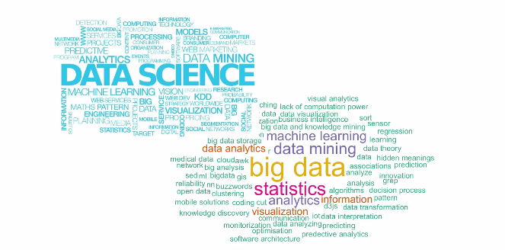
Data Science – Day 5

Slide 2
Modelling
Ordinary Least squares
Y = ax + b
Mother of all models
Linearity
Occam’s razor
Logistic regression
Neural Network
LDA /QDA

Slide 3
Modelling
KNN
Non Parametric
Suitable for less dimensions
Lazy Learner

Slide 4
Modelling
SVM
Powerful
Applies kernel trick for dimensionality

Slide 5
Modelling
Electronics
Mechanical
f
Decision Trees
More suitable for non linear data
Promotes model averaging techniques
Sports
e
d
XGBoost
RandomForest
CART
a
b
c
Academics

Slide 6
Modelling Rudiments
www.r2d3.us/visual-intro-to-machine-learning-part-1/
b) Data distribution governs the model.
c) Model interpretability and efficiency should be traded off.
d) Simplest definition should be always taken into consideration.
e) Linearity should be always checked.
Feature engineering precedes Data Modelling
No free lunch theorem

